Slide 1

Online Conference Management Tool
User Guide
2021S1_REG_WD_17

Slide 2
Preparing Environment
Download Google Chrome from below link
https://www.google.com/chrome/
Install and Open the web browser
In the address bar type the given website link
https://iconconference.herokuapp.com/
Login in using the given credentials

Slide 3
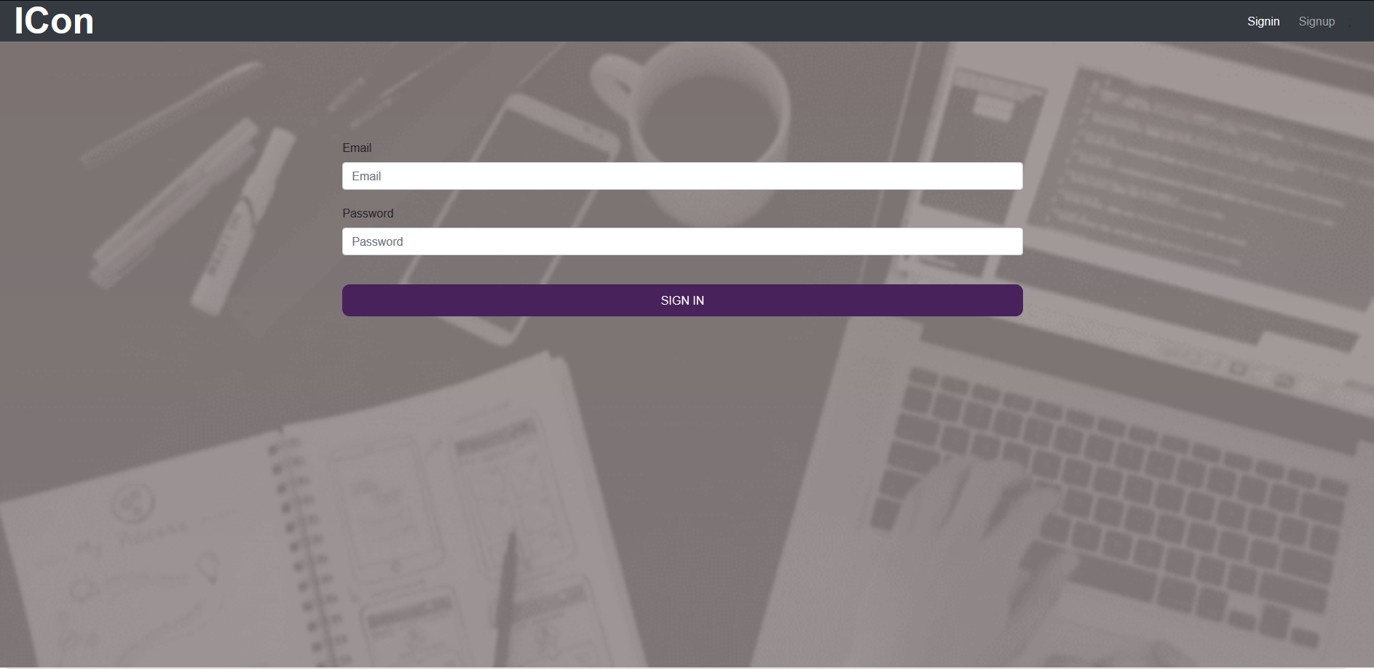
sign using given credentials

Slide 4
Login Guide
Admin
Enter username-kasun98@gmail.com
Enter password-kasun98
You will be redirect to Home page
Reviewer
Enter username-dew98@gmail.com
Enter password-deww98
You will be redirect to Home page
Attendee
Enter username-dana98@gmail.com
Enter password-dana98
You will be redirect to Home page

Slide 5
Workshop conductor
Enter username-arohi@gmail.com
Enter password-arohi98
You will be redirect to Home page
Researcher
Enter username-saman98@gmail.com
Enter password-saman98
You will be redirect to Home page
Editor
Enter username-malan98@gmail.com
Enter password-malan98
You will be redirect to Home page

Slide 6
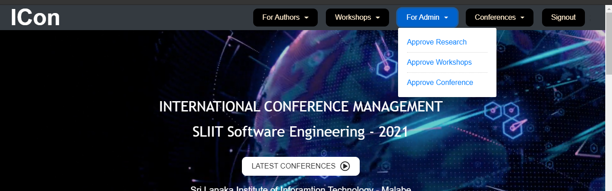
For Reviewer Approve Research papers
Logging As Reviewer
Click Approve Research papers
Redirect to Reviewer dashboard
Click approve or reject Research papers

Slide 7
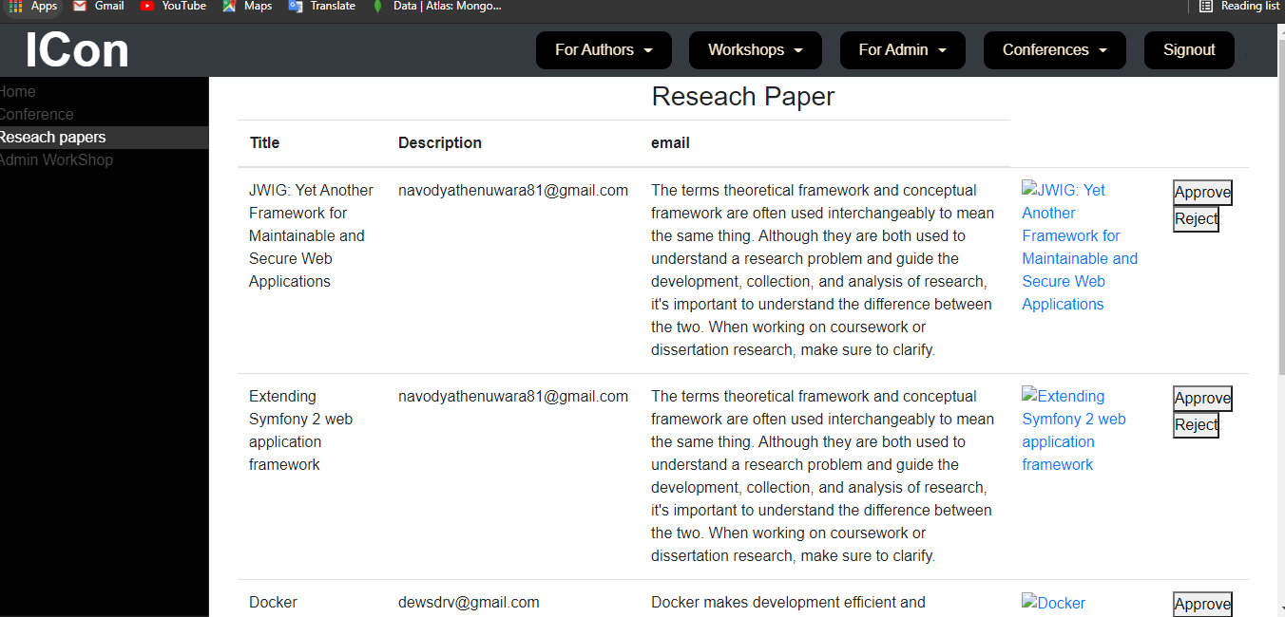

Slide 8
Approve workshops
Logging As Reviewer
Click Approve Workshops
Redirect to Admin dashboard
Click approve and approve workshops

Slide 9
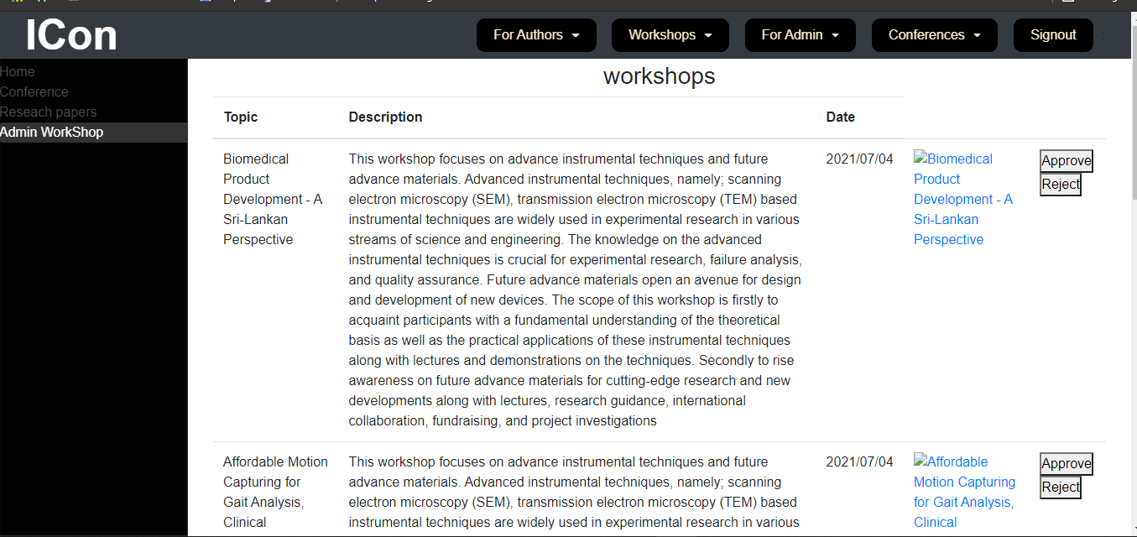

Slide 10
For Admin Approve conference
Logging As Admin
Click Approve conferences
Redirect to Admin dashboard
Click approve and approve conferences

Slide 11
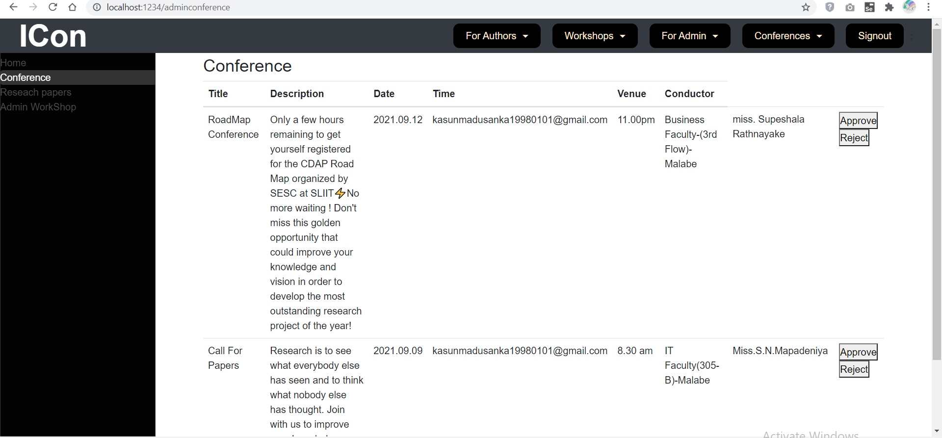

Slide 12
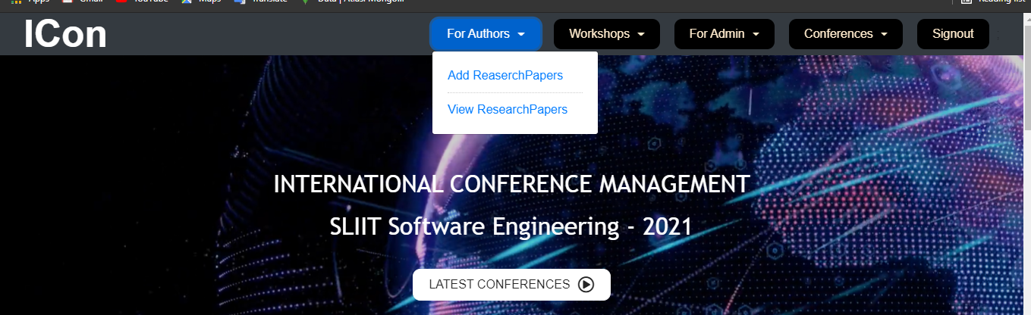
For Author Add research papers
Click add research papers and fill the form
Add research paper
Click submit button

Slide 13
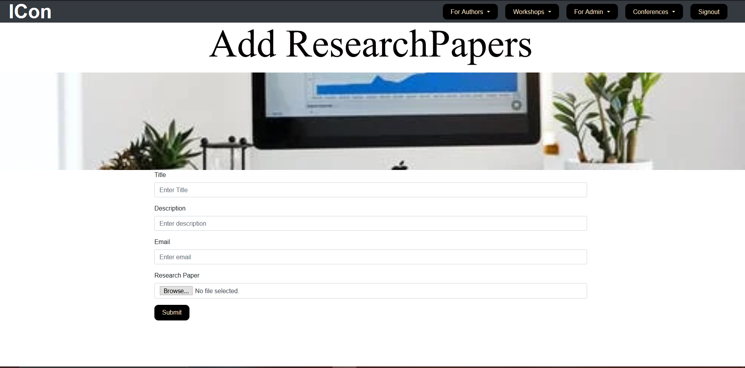
Add research papers

Slide 14

View Research papers

Slide 15
Click download button and download research paper make payment clicking pay button

Slide 16
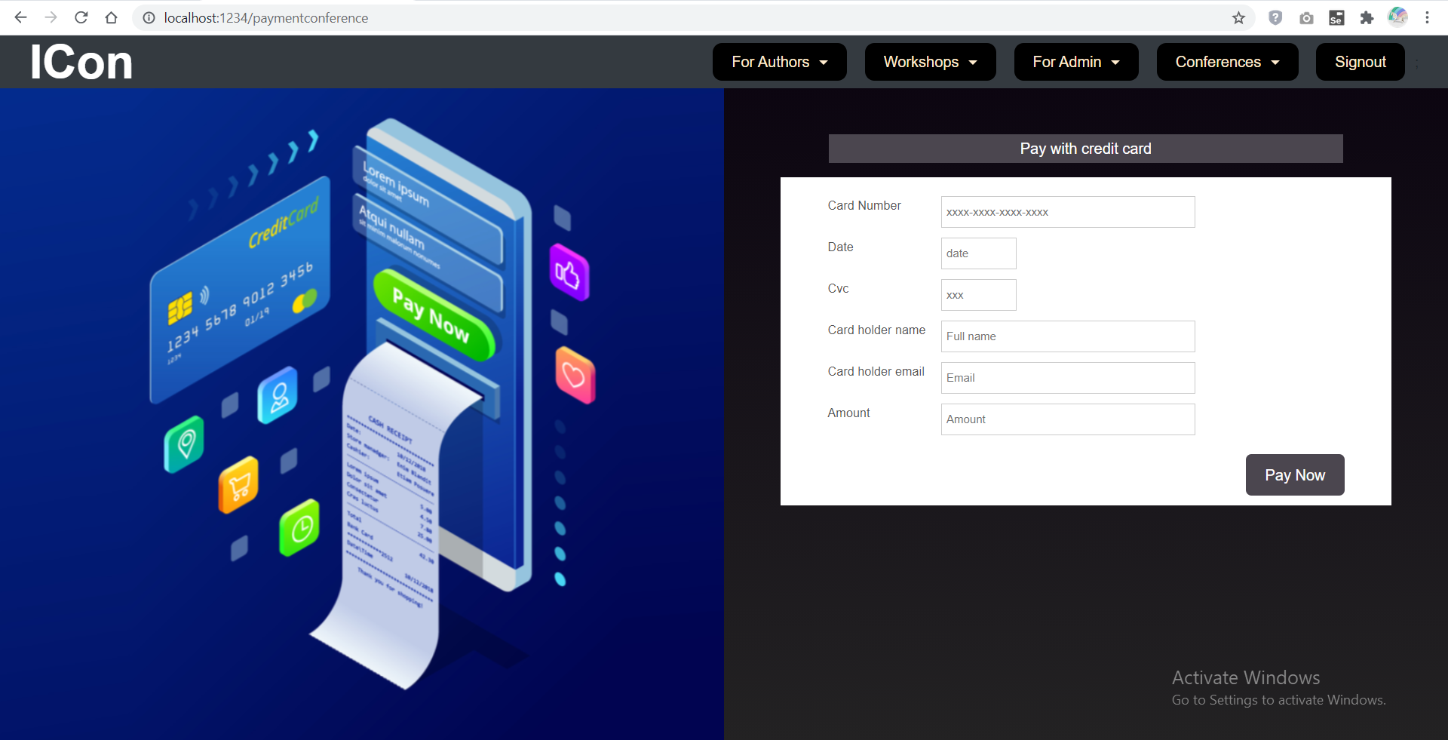
Click on pay button
It will navigate to payment page

Slide 17

For Workshop conductors Add workshops
Click add workshops
Add workshop proposals
Click submit button

Slide 18
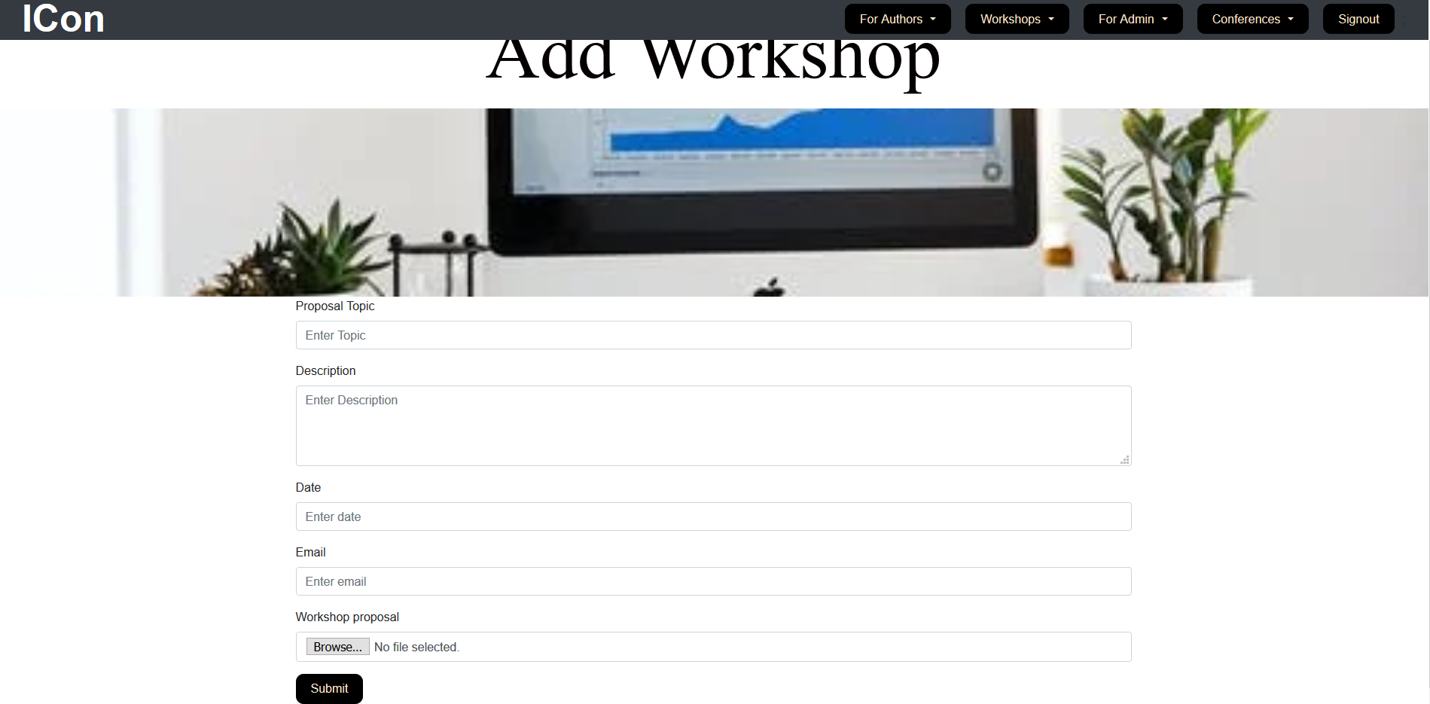
Add workshops

Slide 19
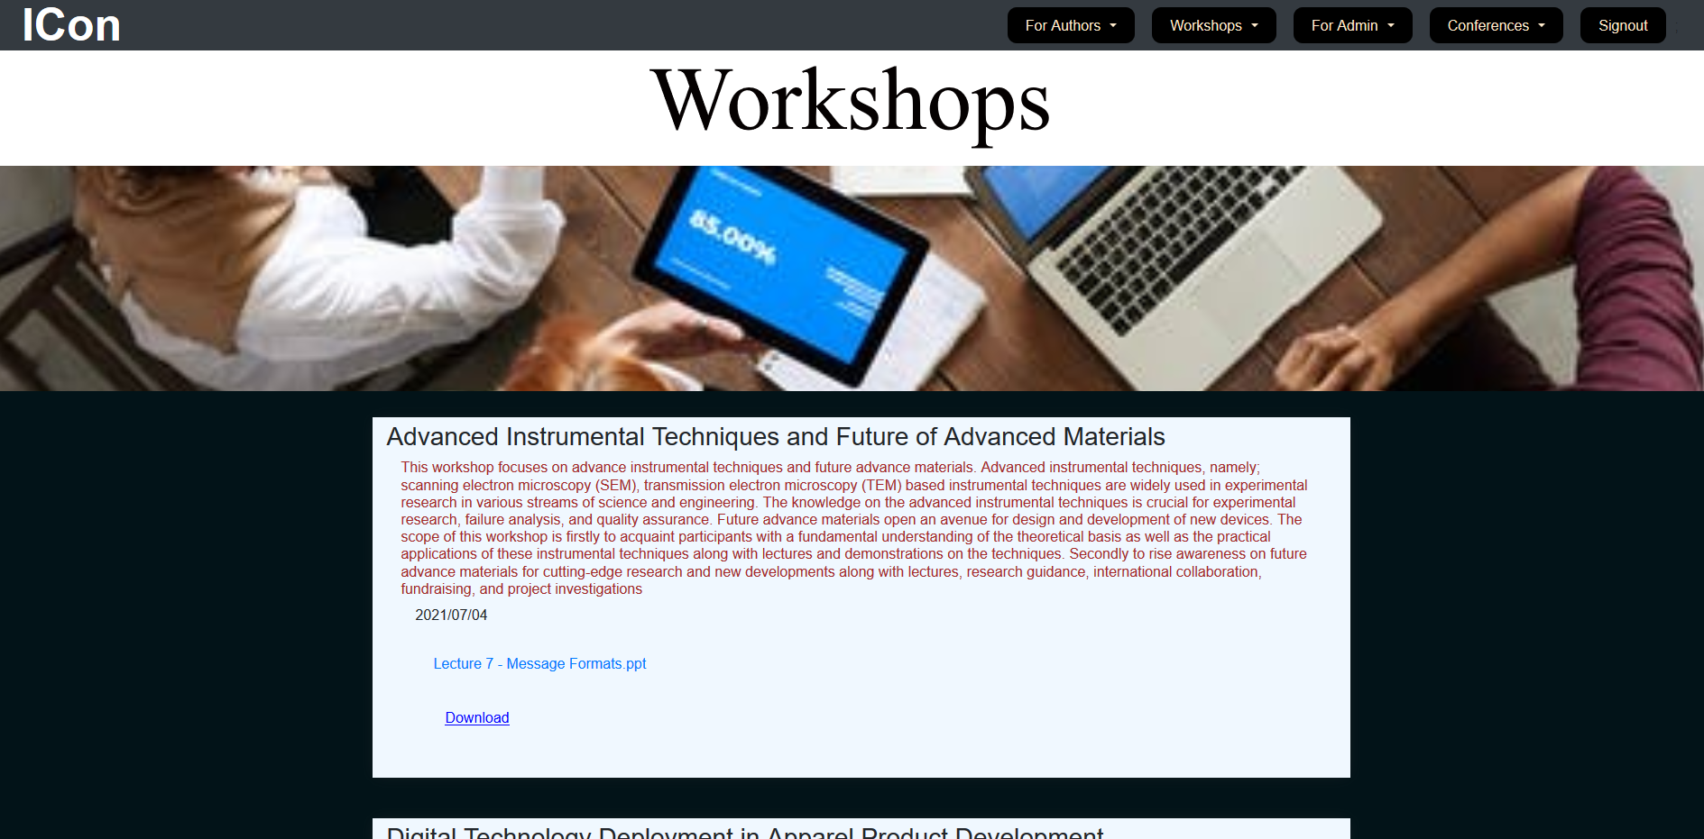
View workshops
Click download button if you want to download workshops

Slide 20
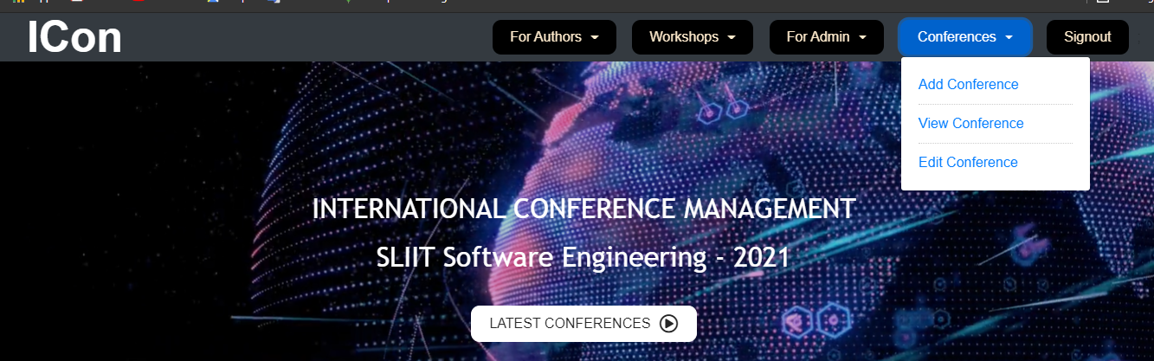
For Editors Add conference
Click add conference
Add conference
Click submit button

Slide 21
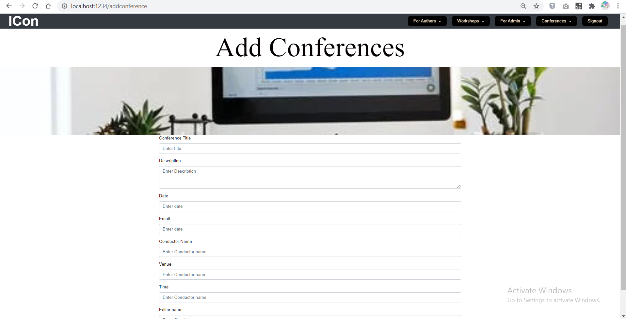
Add Conferences

Slide 22
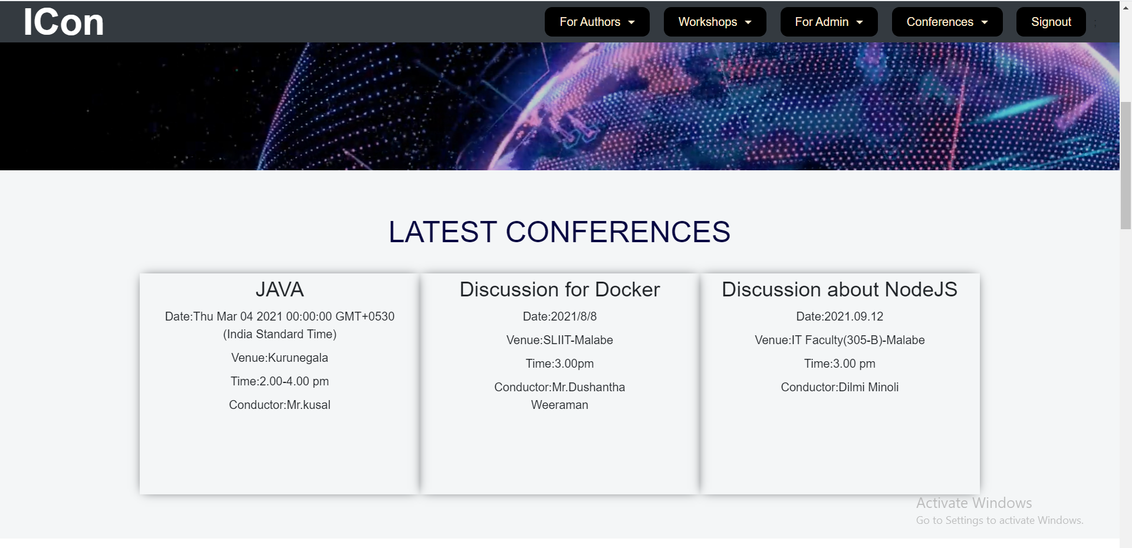
View Conferences To Unregistered Users

Slide 23
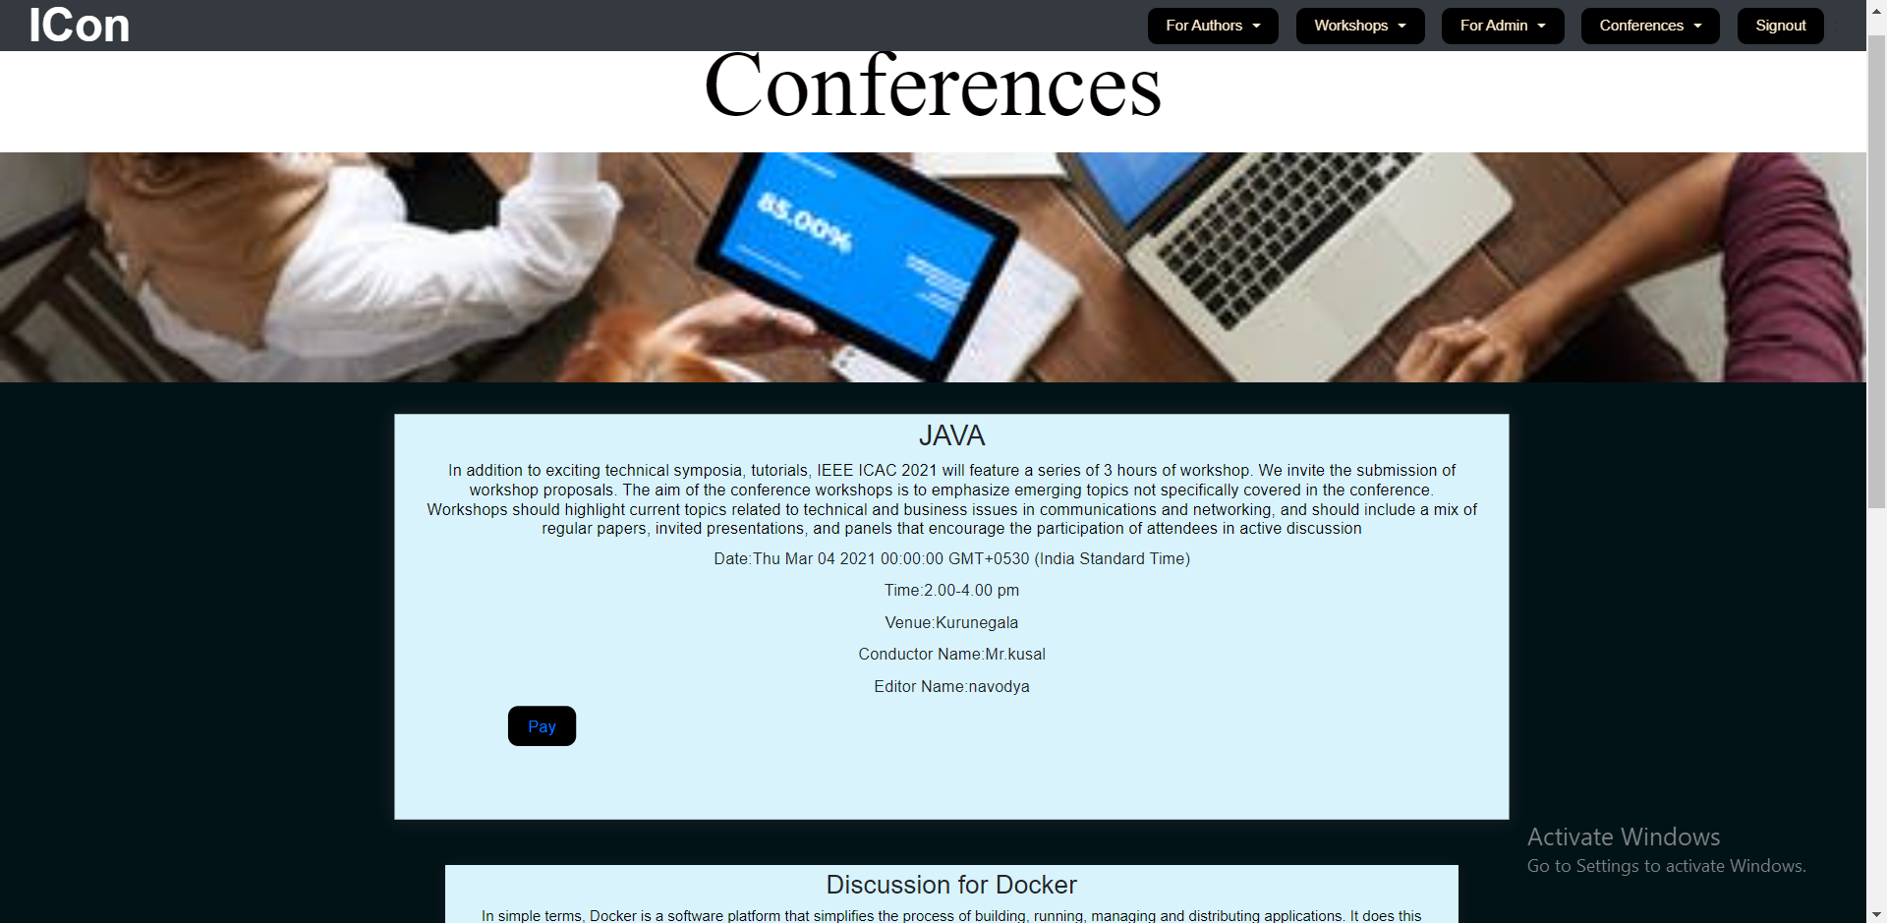
To Registered users

Slide 24
To make payment click on pay button and it navigate to payment page

Slide 25
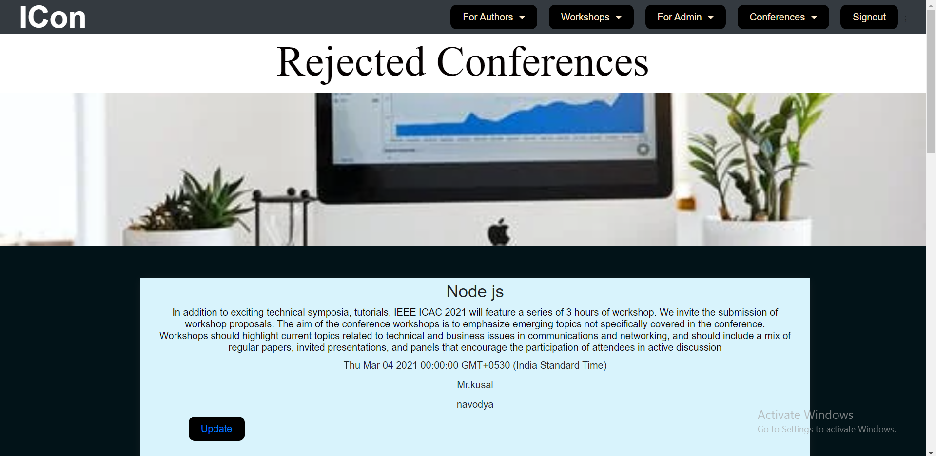
View Editor- Rejected Conference List

Slide 26
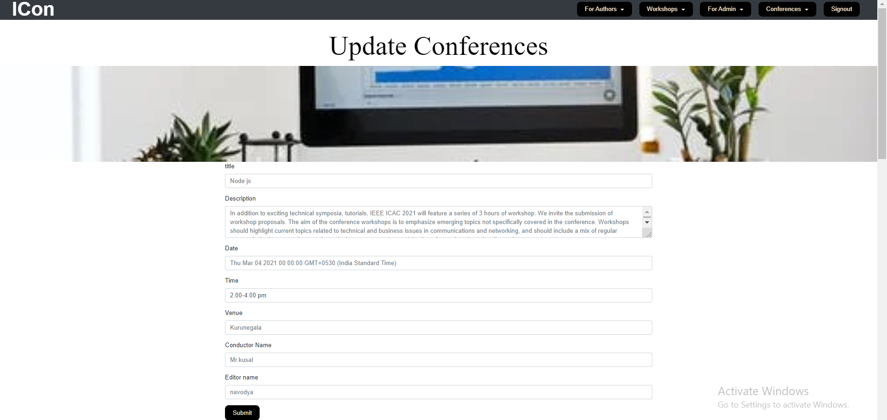
Update Conference

